Slide 1
Team raksha presents : child tracker with emergency notifier
BY
M MVNS Madhan mohan
B Indrakiranreddy
P Jagadeesh

Slide 2
DESCRIPTION:
Geo-fencing/Virtual fencing is a feature in a software program that uses the global positioning system, more commonly referred to as GPS, to define geographical boundaries. A geo-fence is a virtual barrier.
Our device may help parents track their kid’s activity. This device is the smart wearable equipped with GSM and GPS which intern integrated Web App with geo-fence technology and an Android App.
With Android app you can set an innovative geo-fence around your house. This will allow you to get instant alerts on your phone if your kid leaves your pre-set designated area.
However, if your kid is away from geo-fence, you can then track them with Device GPS features. In addition, your geo-fence can be customized through mobile App.

Slide 3
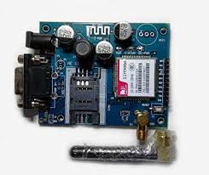
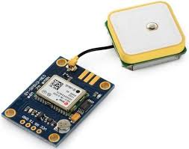
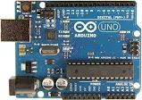
Libraries used :
TinyGPS++
SoftwareSerial.h
Hardware used:
GPS module
GSM/GPRS module
Arduino
GSM module
GPS module
ARDUINO

Slide 4
TinyGPS++ :
TinyGPS++ is a Arduino library for parsing NMEA data streams provided by GPS modules.
This library provides compact and easy-to-use methods for extracting position, date, time, altitude, speed, and course from consumer GPS devices.
TinyGPS++’s programmer interface is considerably simpler to use than TinyGPS
The new library can extract arbitrary data from any of the myriad NMEA sentences out there, even proprietary ones.

Slide 5
SoftwareSerial.h :
The SoftwareSerial Library has been developed to allow serial communication to take place on the other digital pins of your boards
Using software to replicate the functionality of the hardwired RX and TX lines.
This can be extremely helpful when the need arises to communicate with two serial enabled devices, or to talk with just one device while leaving the main serial port open for debugging purpose.
The virtual RX pin is set up to listen for anything coming in on via the main serial line, and to then echo that data out the virtual TX line. Conversely, anything received on the virtual RX is sent out over the hardware TX

Slide 6
GEO-FENCE :
A geo-fence is a virtual perimeter for a real-world geographic area. A geo-fence could be dynamically generated—as in a radius around a point location, or a geo-fence can be a predefined set of boundaries.
The use of a geo-fence is called geo-fencing, and one example of usage involves a location-aware device of a location-based service (LBS) user entering or exiting a geo-fence.
This activity could trigger an alert to the device's user as well as messaging to the geo-fence operator.
This info, which could contain the location of the device, could be sent to a mobile telephone or an email account.

Slide 7
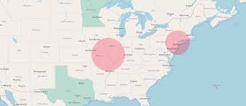
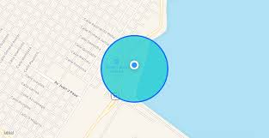
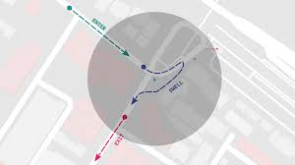
EXAMPLES OF GEO-FENCE :

Slide 8
APPLICATION OF GEO-FENCE :
Geofencing, used with child location services, can notify parents if a child leaves a designated area.
Geofencing used with locationized firearms can restrict those firearms to fire only in locations where their firing is permitted, thereby making them unable to be used elsewhere.
In some companies, geofencing is used by the human resource department to monitor employees working in special locations especially those doing field works. Using a geofencing tool, an employee is allowed to log his or her attendance using a GPS-enabled device when within a designated perimeter.
Other applications include sending an alert if a vehicle is stolen and notifying rangers when wildlife stray into farmland.
Geo-fence can be used for location based messaging for tourist safety and communication.

Slide 9
CONCLUSION :
By designing the child tracker it will be easy to the parents to track the children when they miss contact with the children when the child goes out of the geo-fence,parents can track the location of the child using this design,This will allow you to get instant alerts on your phone if your kid leaves your pre-set designated area.

